Slide 1

“When You Are Converted”
How God Turns Attenders
Into Strengtheners
Luke 22:32
Notes:
Stuart Fain ~ April 19, 2026

Slide 2
Luke‬ ‭22‬:‭32‬ ‭(KJV) ‬‬
But I have prayed for thee, that thy faith fail not: and when thou art converted, strengthen thy brethren.

Slide 3
Luke‬ ‭22‬:‭31‬-‭34‬ ‭(NASB)‬‬ ‬‬‬
³¹ "Simon, Simon, behold, Satan has demanded to sift you men like wheat; ³² but I have prayed for you, that your faith will not fail; and you, when you have turned back, strengthen your brothers."

Slide 4
Luke‬ ‭22‬:‭31‬-‭34‬ ‭(NASB)‬‬ ‬‬‬‬
³³ But he said to Him, "Lord, I am ready to go with You both to prison and to death!" ³⁴ But He said, "I tell you, Peter, the rooster will not crow today until you have denied three times that you know Me."

Slide 5
Vines NT Dictionary
Epistrepho (ep-ee-stref’-o)
"to turn about, turn towards"
It is a verb directed at a specific object (Simon), and so rendered "convert" (of causing a person to turn), to turn fully, decisively, completely.

Slide 6
What the Bible Teaches About Conversion:
Tolerating the Minimum Leads to Sifting
Turning Completely Is the Heart of Conversion
Transforming Others Is the Evidence of Conversion

Slide 7
Point #1: Tolerating the Minimum Leads to Sifting
James 1:6-8 (NASB)
Hebrews 12:25-27 (NLT)

Slide 8
James 1:6-8 (NASB)
⁶ But he must ask in faith without any doubting, for the one who doubts is like the surf of the sea, driven and tossed by the wind.

Slide 9
James 1:6-8 (NASB)
⁷ For that person ought not to expect that he will receive anything from the Lord, ⁸ being a double-minded man, unstable in all his ways.

Slide 10
Hebrews 12:25-27 (NLT)
²⁵ Be careful that you do not refuse to listen to the One who is speaking. For if the people of Israel did not escape when they refused to listen to Moses, the earthly messenger,

Slide 11
Hebrews 12:25-27 (NLT)
we will certainly not escape if we reject the One who speaks to us from heaven! ²⁶ When God spoke from Mount Sinai his voice shook the earth, but now he makes another promise:

Slide 12
Hebrews 12:25-27 (NLT)
"Once again I will shake not only the earth but the heavens also." ²⁷ This means that all of creation will be shaken and removed, so that only unshakable things will remain.

Slide 13
Hebrews 12:25-27 (NLT)
²⁸ Since we are receiving a Kingdom that is unshakable, let us be thankful and please God by worshiping him with holy fear and awe.
²⁹ For our God is a devouring fire.

Slide 14
Point #2: Turning Completely Is the Heart of Conversion
Psalms 37:4-6 (NASB)
Mark 8:34 (NASB)
Psalms 1:1-3 (NASB)

Slide 15
Psalms 37:4-6 (NASB)
⁴ Delight yourself in the LORD; And He will give you the desires of your heart.
⁵ Commit your way to the LORD, Trust also in Him, and He will do it.

Slide 16
Psalms 37:4-6 (NASB)
⁶ He will bring out your righteousness as the light, And your judgment as the noonday.

Slide 17
Preaches the 1st Gospel Sermon | Acts 2:14
Ministers Boldly in the Temple | Acts 3:6
Boldly Preaches Jesus as the Only Name that Matters | Acts 4:12-13
Prioritizes Obedience to God Over Men | Acts 5:29
Teaches Others How to be Converted | I Peter 5:10

Slide 18
Mark 8:34 (NASB)
And He summoned the crowd together with His disciples, and said to them, "If anyone wants to come after Me, he must deny himself, take up his cross, and follow Me.

Slide 19
Psalms 1:1-3 (NASB)
¹ Blessed is the person who does not walk in the counsel of the wicked,
Nor stand in the path of sinners, Nor sit in the seat of scoffers!
² But his delight is in the Law of the LORD, And on His Law he meditates day and night.

Slide 20
Psalms 1:1-3 (NASB)
³ He will be like a tree planted by streams of water, Which yields its fruit in its season, And its leaf does not wither; And in whatever he does, he prospers.

Slide 21
Point #3: Transforming Others Is the Evidence of Conversion
Romans 15:1-3 (NASB)
I Thessalonians 5:14-24 (NASB)

Slide 22
Romans 15:1-3 (NASB)
¹ Now we who are strong ought to bear the weaknesses of those without strength, and not just please ourselves. ² Each of us is to please his neighbor for his good, to his edification.

Slide 23
Romans 15:1-3 (NASB)
³ For even Christ did not please Himself, but as it is written: "THE TAUNTS OF THOSE WHO TAUNT YOU HAVE FALLEN ON ME."

Slide 24
I Thessalonians 5:14-24 (NASB)
¹⁴ We urge you, brothers and sisters, admonish the unruly, encourage the fainthearted, help the weak, be patient with everyone.

Slide 25
I Thessalonians 5:14-24 (NASB)
¹⁵ See that no one repays another with evil for evil, but always seek what is good for one another and for all people.

Slide 26
I Thessalonians 5:14-24 (NASB)
¹⁶ Rejoice always, ¹⁷ pray without ceasing, ¹⁸ in everything give thanks; for this is the will of God for you in Christ Jesus.

Slide 27
I Thessalonians 5:14-24 (NASB)
¹⁹ Do not quench the Spirit, ²⁰ do not utterly reject prophecies, ²¹ but examine everything; hold firmly to that which is good, ²² abstain from every form of evil.

Slide 28
I Thessalonians 5:14-24 (NASB)
²³ Now may the God of peace Himself sanctify you entirely; and may your spirit and soul and body be kept complete, without blame at the coming of our Lord Jesus Christ.

Slide 29
I Thessalonians 5:14-24 (NASB)
²⁴ Faithful is He who calls you, and He also will do it.

Slide 30
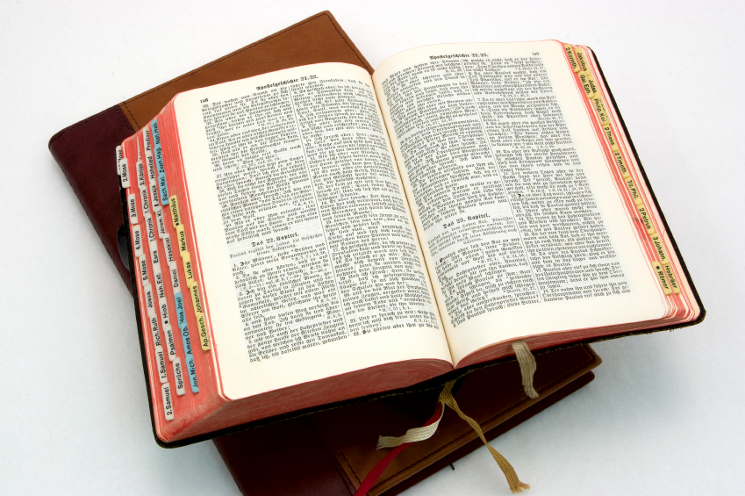
Hear: Romans 10:17
So then faith cometh by hearing, and hearing by the word of God.

Slide 31
Believe: Hebrews 11:6
But without faith it is impossible to please him: for he that cometh to God must believe that he is, and that he is a rewarder of them that diligently seek him.

Slide 32
Repent: Luke 13:3
I tell you, Nay: but, except ye repent, ye shall all likewise perish.

Slide 33
Confess: Matthew 10:32-33
32 Whosoever therefore shall confess me before men, him will I confess also before my Father which is in heaven.
33 But whosoever shall deny me before men, him will I also deny before my Father which is in heaven.

Slide 34
Baptize: Acts 22:16
And now why tarriest thou? arise, and be baptized, and wash away thy sins, calling on the name of the Lord.

